Slide 1
Characterization of MPI Usage on a Production Supercomputer
Sudheer Chunduri, Scott Parker, Pavan Balaji, Kevin Harms, Kalyan Kumaran
Argonne National Laboratory

Slide 2
Acknowledgements
This research used resources of the Argonne Leadership Computing Facility, which is a DOE Office of Science User Facility supported under Contract DE-AC02-06CH11357
This research was supported by the Exascale Computing Project (17-SC-20-SC), a collaborative effort of the U.S. Department of Energy Office of Science and the National Nuclear Security Administration
ANL Darshan Team
ANL Computational Scientists
ALCF Operations Team
Anonymous reviewers

Slide 3
Why this study?
MPI is a prominent programming model used for production scientific computing
Around 90% of all the applications run on ANL’s production machine (Mira) use MPI
IBM BG/Q MPI based on ANL MPICH
Different applications have different requirements for parallelism and could be using different features of MPI
How scientific computing applications use MPI in production?
It is imperative to glean into the MPI feature set exploration by production applications
To assess how efficiently MPI is being used
Identify areas of concern in terms of performance of MPI features
Why such a study is not common?
Performance overhead with profiling tools
Lack of production quality lightweight profiling tools
Related: “A survey of MPI usage in the US exascale computing project”, David Bernholdt et al.

Slide 4
Motivation
How the insights from this study can be used?
Facility Perspective
How important is MPI?
What fraction of the total core-hours is spent in MPI?
If MPI performance is improved by X%, we could save on Y% of resource usage
What is the typical use of MPI in key production codes
Which collectives are crucial in terms of core-hour usage?
Explore site-specific tuning of MPI
MPI developers
“An application perspective feedback to the MPI forum is missing” – ExaMPI 2018 Panel
Message size distributions or ranges – to explore algorithmic tuning optimizations
Application users
Feedback to users on how the MPI usage could be improved
Notes:
Enable applications to scale-out further on the strong scaling limit

Slide 5
AutoPerf - lightweight profiling tool
Automatic performance collection of hardware performance counter and MPI information
MPI Intercepts each MPI call using the PMPI interface
Hardware counters using BGPM
Library transparently collects & logs performance data from running jobs
Captures on all MPI ranks
{callCount, totalCycles, totalBytes, totalTime} for all and pt2pt & collectives
But reports from 4 (exclusive) ranks
Rank 0
Rank that has minimum MPI time
Rank that has maximum MPI time
Rank that has average MPI time
Data recorded on the average rank is used in this study
Can see some of the load imbalance but not fine grained
Can incorrectly blame MPI by accounting load imbalance time as MPI time
Overhead: adds around 300 processor cycles per MPI call
Overhead in the range of 0.05% for production scale applications
No reported issues in production
Notes:
https://www.alcf.anl.gov/user-guides/automatic-performance-collection-autoperf
Cobalt log – get the core hour data
Autoperf logs are available for around ~70% of the jobs run on Mira for the last ~2 years.
Total logs available: 503,067
Total core hours captured through logs: 12,688,109,540,376 (12 trillion seconds)
Job size ranges from 1 to 1,048,576 ranks
Job time ranges from 8 micro-seconds to 24 hours
MPI average bytes are calculated from the buffer size in bytes used for the MPI calls

Slide 6
Outline (methodology used in this study)
Understand characteristics of Jobs in 2 years (2016-2017) of Mira
Job sizes and Job lengths
Job categorization based on executable/application names
Make sure to consider jobs representing production applications only
Coverage of Autoperf
MPI usage characteristics across all the Autoperf jobs
MPI Collectives
Message sizes & time distributions for the collectives
Message buffer sizes
MPI Point-to-point operations
Time in blocking vs. non-blocking point-to-point operations
MPI usage in top (top core hour consumer) applications
Summary
Notes:
I think the idea of section 1 on jobs is to know how well is coverage of data. (Data covers all the possible job sizes, all the possible runtime, all the possible MPI fractions..)
We are trying to justify that the data is representative of what goes on the system typically, and that any observations we make based on that data has metric.

Slide 7
Overview of all jobs on Mira in 2 years
job - control system job

Slide 8
Job filtering
Filtering Criteria used: Executables that take < 0.1% of the Total core hours (11.6 Bi) are removed
job - control system job

Slide 9
Coverage by Autoperf
Filtering Criteria used: Executables that take < 0.1% of the Total core hours (11.6 Bi) are removed
Missing Autoperf coverage:
Jobs for applications that do not use MPI
Jobs that explicitly disabled Autoperf (users can disable AutoPerf by using env. variable (AP_DISABLE=1))
Jobs using other tools/instrumentation such BGPM/PAPI/PMPI
Jobs that aborted before MPI_Finalize
Jobs aborted due to node/system failures
job - control system job
Notes:
Successful jobs - clean MPI_Finalize
Aborted jobs - aborted before reaching MPI_Finalize - would not have Autoperf log

Slide 10
Are Autoperf jobs representative of all jobs in job sizes?
% of core-hours per different job sizes
Implicitly includes
Job counts
Job lengths (duration)
Job sizes
Distribution of core-hours across the different allocation sizes for Autoperf jobs are representative of the Filtered/All jobs.
Notes:
How the core-hours for these three category of jobs is distributed among the different job sizes.

Slide 11
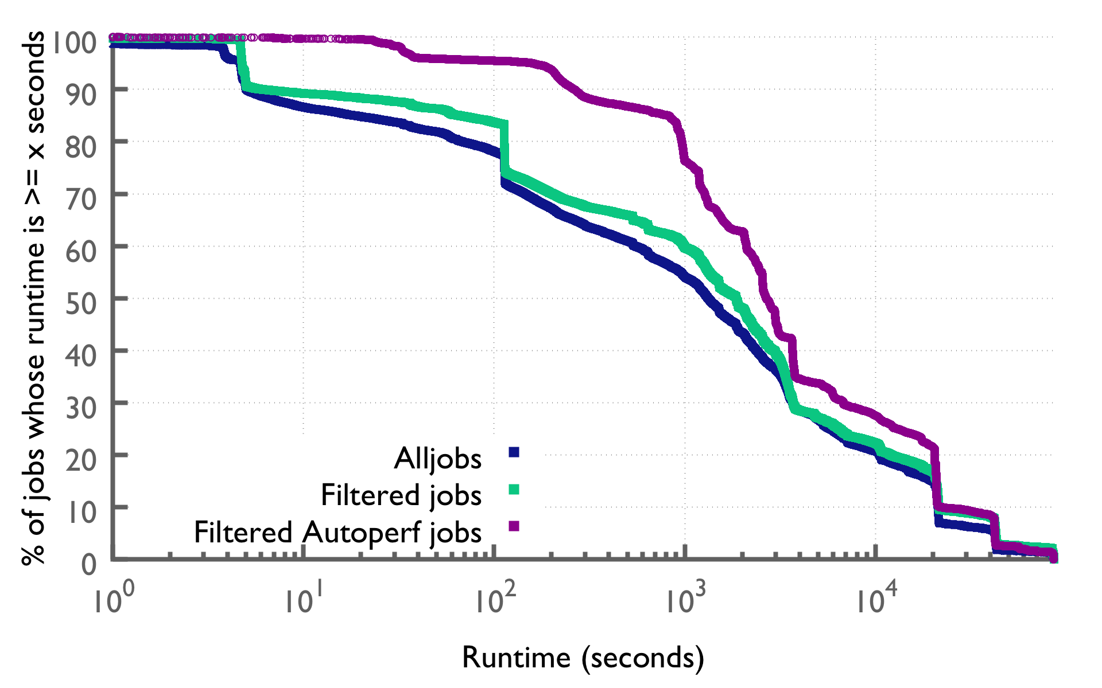
Are Autoperf jobs representative of all jobs in runtimes?
CDF (Cumulative distribution function):
How often runtime is below a particular value
CCDF (Complementary cumulative distribution functions): Opposite
How often runtime is above or equal to a particular value
Jobs are ordered by runtime

Slide 12
Are Autoperf jobs representative of all jobs in runtimes?
CCDF (Complementary cumulative distribution functions)
80% of the Autoperf jobs have runtime > 1000 seconds

Slide 13
Are Autoperf jobs representative of all jobs in runtimes?
CCDF (Complementary cumulative distribution functions)
80% of the Autoperf jobs have runtime > 1000 seconds
Jobs that have runtimes less than 10s of seconds are filtered out
There could still be some runs of unfiltered apps that take smaller runtimes
Notes:
The range of Autoperf jobs’ runtimes starts at a higher value than Filtered jobs

Slide 14
Autoperf jobs are representative of production jobs
We establish the following claims about the Autoperf log data:
The Autoperf log data covers the spread of the different job sizes possible on Mira
It covers a significant range of the runtimes possible
The core-hour consumption range wrt to different job sizes is also reasonable
Represents only the production applications
Represents multi-year production usage captured from around 86K jobs
Hence, we argue that observations we make in the following slides using this data have significant merit

Slide 15
Global MPI usage patterns across all (Autoperf) Jobs

Slide 16
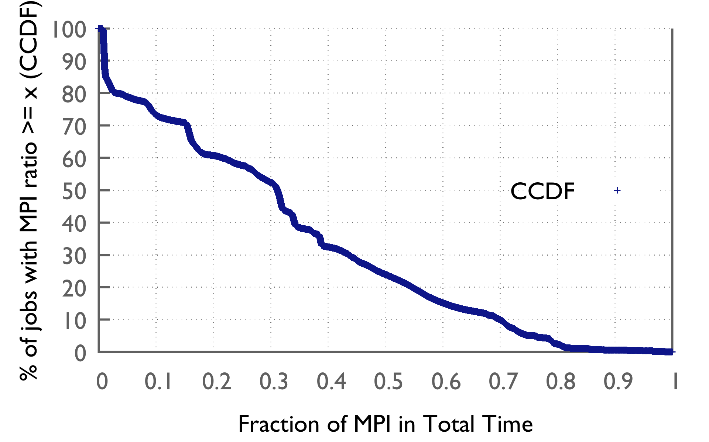
Fraction of MPI time for Autoperf jobs
The plot represent the jobs among the Filtered jobs that have an Autoperf log
Around half of the jobs have 30% or more time spent in MPI
Notes:
Core hours – total core hours in MPI vs. total core-hours…

Slide 17
Fraction of MPI time for Autoperf jobs
The plot represent the jobs among the Filtered jobs that have an Autoperf log
Around half of the jobs have 30% or more time spent in MPI
Around 15% of the jobs have 60% or mote time spent in MPI
Notes:
Core hours – total core hours in MPI vs. total core-hours…

Slide 18
Fraction of MPI time for Autoperf jobs
The plot represent the jobs among the Filtered jobs that have an Autoperf log
Around half of the jobs have 30% or more time spent in MPI
Around 15% of the jobs have 60% or more time spent in MPI
Roughly 34% of core-hours on Mira are expended in MPI
A significant portion of resources is accounted by time spent in MPI (communication & synchronization & load imbalance)
Hence, optimizing MPI can optimize the performance of applications; thus saving on the core-hour budget
Notes:
Core hours – total core hours in MPI vs. total core-hours…

Slide 19
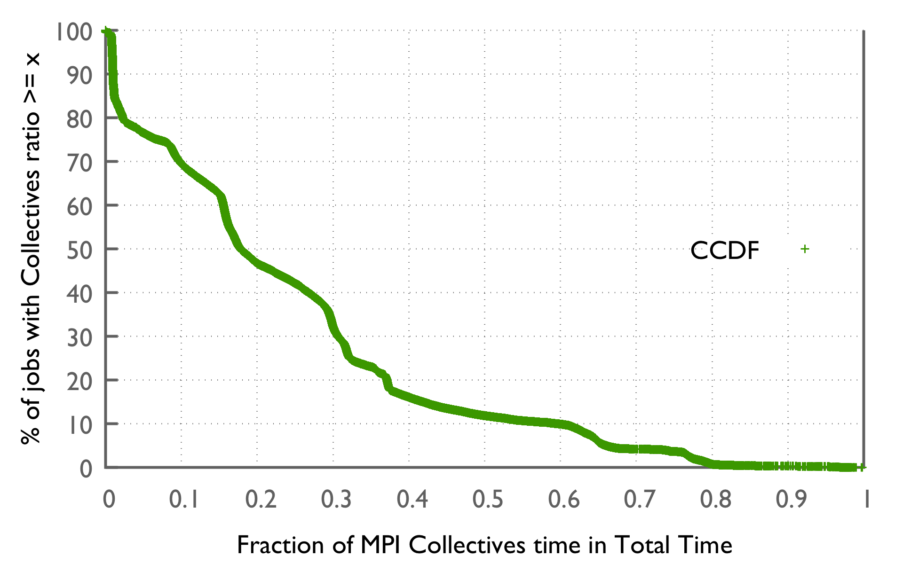
Collectives & point-to-point fraction for Autoperf jobs
Mira jobs ordered by their respective Collectives fraction in total time
10% of the jobs spent a large portion (60% or more) of time in Collectives
Notes:
Core hours – total core hours in MPI vs. total core-hours…

Slide 20
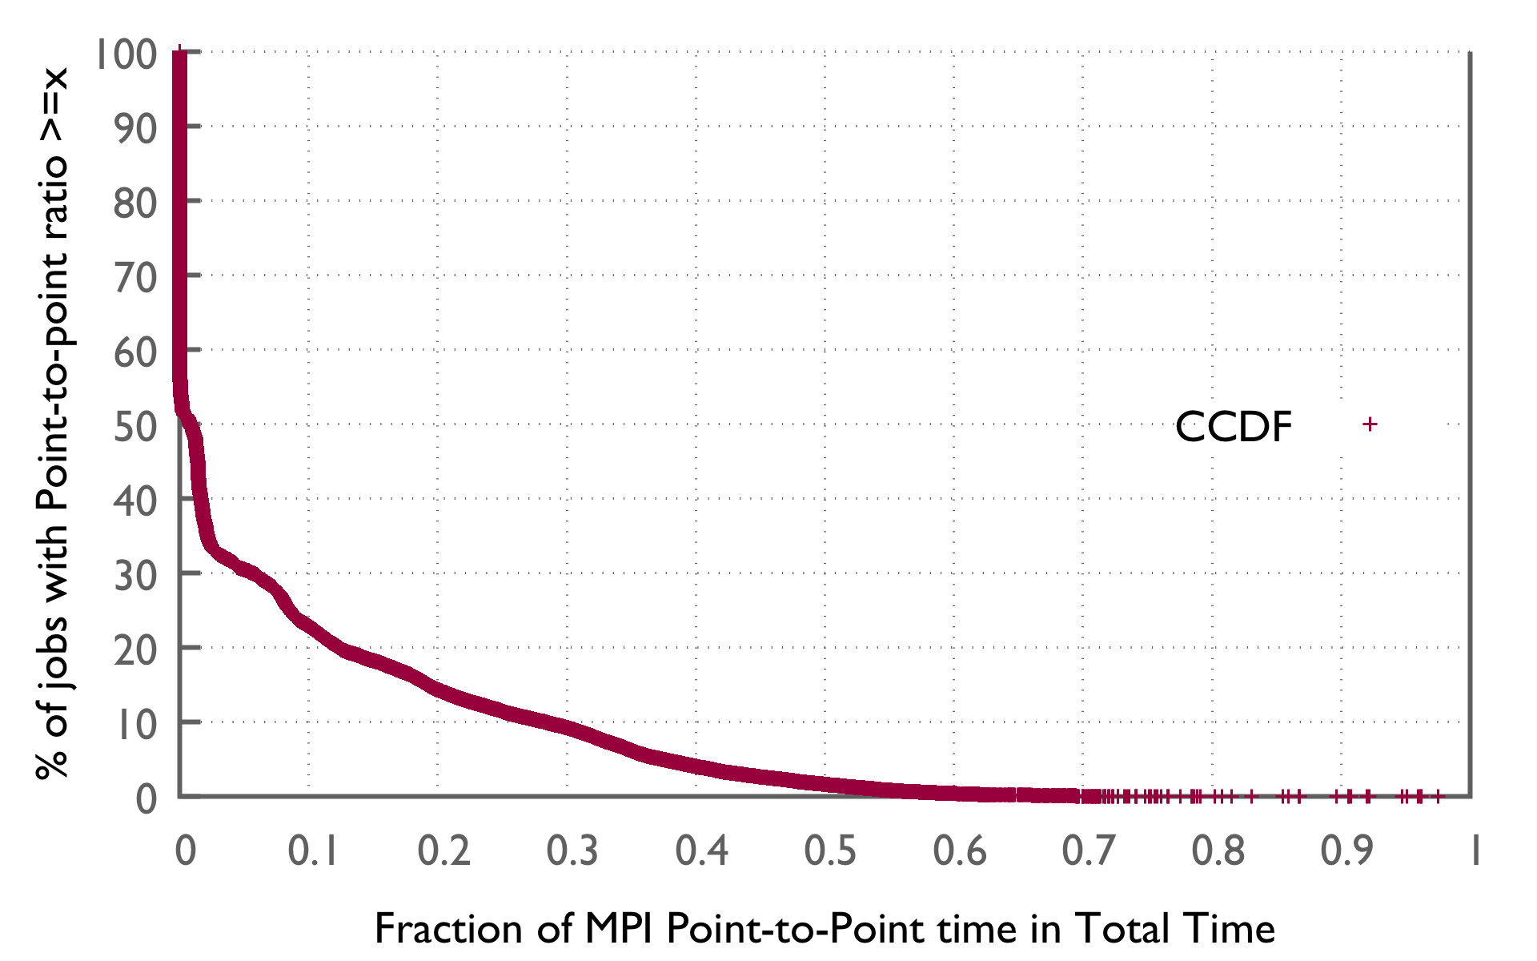
Collectives & point-to-point fraction for Autoperf jobs
Mira jobs ordered by their respective Collectives fraction in total time
10% of the jobs spent a large portion (60% or more) of time in Collectives
Mira jobs ordered by their respective point-to-point fraction in total time
50% of the jobs did not use pt-2-pt
Notes:
Core hours – total core hours in MPI vs. total core-hours…

Slide 21
MPI COLLECTIVES MPI COLLECTIVES USAGE ACROSS ALL THE AUTOPERF JOBS ON MIRA
Notes:
We now study how the MPI primitives are used by the applications.

Slide 22
Usage of MPI collectives (call count)
Aggregate call count across all the jobs
Allreduce and Bcast are heavily used compared to the rest of the collectives.

Slide 23
Time spent in collectives
Accumulate the time across all the jobs
Allreduce and Bcast are also prominent primitives in terms of time
Percentage wrt to total core-hours spent in MPI
Notes:
Should be presented this in terms of core hours ….
How important is MPI (what % of core-hours)?

Slide 24
Average bytes (~ buffer size) used in MPI collectives
Average (normalized) bytes = Total bytes/call count
Alltoall and Allreduce are highest in data volume sent on the network
Issues with this data:
Message size distribution is not available – accumulated buffer sizes per collective on a rank is used
Buffer size is not the right metric always (eg: for Scatter and Bcast, Buffer size does not represent the data volume)
Alltoallv data volume is tricky to approximate
Notes:
Multiply with ppn ---
Buffer size…. Not the average bytes.,….
Total bytes ….. Total buffer size …. How much data is moved across network..
Total aggregate buffer sizes…..
TODO: average bytes is not a correct metric. Further, we can’t just multiply with ppn because we don’t have information about comm_create operations.

Slide 25
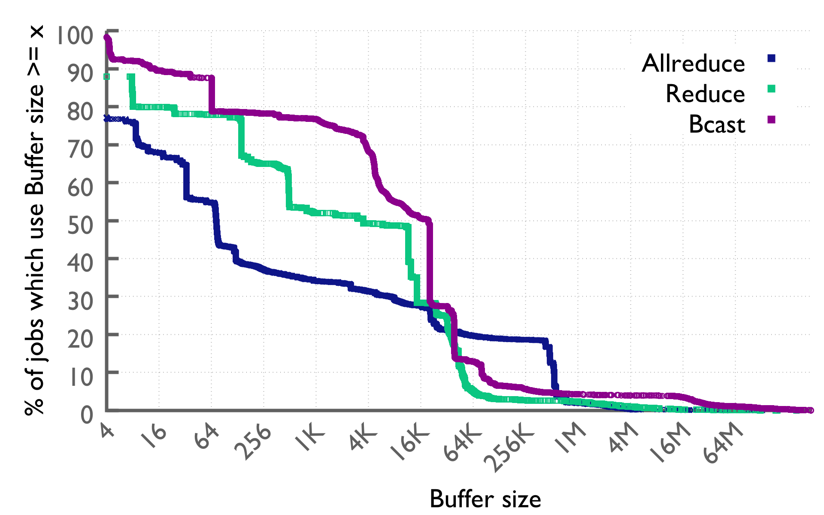
Average bytes used in collectives
Average bytes is recorded from the avg. rank in each job
Small sized reductions (< 256 B) are heavily used (60%)

Slide 26
Average bytes used in collectives
Average bytes is recorded from the avg. rank in each job
Small sized reductions (< 256 B) are heavily used (60%)
Only 5% of the jobs use Bcast of > 1M message size

Slide 27
MPI point-to-point MPI POINT-TO-POINT USAGE ACROSS ALL THE AUTOPERF JOBS ON MIRA

Slide 28
Usage of MPI point-to-point ops (call count)
Aggregate the call count across all the jobs
Non-blocking ops are used more frequently than blocking ops
Potentially exploiting communication-compute overlap
Persistent mode communication is also used
Notes:
Recv -----

Slide 29
Time spent in point-to-point ops
Accumulate the time across all the jobs
Percentage wrt to the Total MPI time (core-hours)
Non-blocking ops are used more frequently than blocking ops

Slide 30
Normalized bytes (~ buffer size) used in MPI point-to-point ops
Normalized bytes = Total bytes/call count
Use this data to explore potential optimizations to Eager/Rendezvous switch
Communicator hint optimizations?
Notes:
Multiply with ppn ---
Buffer size…. Not the average bytes.,….
Total bytes ….. Total buffer size …. How much data is moved across network..
Total aggregate buffer sizes…..

Slide 31
MPI usage in Production Applications on Mira

Slide 32
Autoperf logs - applications ordered by MPI fraction (Portion of time in MPI within the executable runtime)
Total 86K jobs comes from 64 Applications
Order all applications in Autoperf logs (64 executables) by their MPI fraction
Quantum Chemistry Astrophysics Abinitio MD Climate CFD
Materials (MD) Electronic Structure (DFT) Neuroscience Turbulence QCD
Plasma Physics Perturbation Theory Weather Particle Physics
Lattice QCD 3D Magneto Hydrodynamics Engineering Computer Science
Notes:
This one (fix std)
Remove benchmarks and jobs taking less than 1 hour.

Slide 33
Autoperf logs - applications ordered by MPI fraction (Portion of time in MPI within the executable runtime)
15 out of 64 applications have an MPI >= 60%
Half of the applications have an MPI >= 40%
Errorbars: indicate runtime differences across different runs of the same application
Possibly they were run with different inputs, different communication characteristics at different scales
Notes:
This one (fix std)
Remove benchmarks and jobs taking less than 1 hour.

Slide 34
Applications - usage of MPI primitives in time
Applications ordered by the core-hours
34% of the total MPI time is spent in Point-to-point Ops
66% of the total MPI time is spent in collectives
Some of the top core-hour consuming applications have high MPI time fractions
High core-hour usage
low core-hour usage
Notes:
30apps_forpie has the % data.

Slide 35
Summary

Slide 36
Some of the insights
General assumption: Most production applications tend to spend less than a quarter of their time in MPI
Our study on Mira shows that a reasonably high number of applications spend more than half their time in MPI (either due to load imbalance or in real communication)
Collectives are more significantly used than point-to-point
With the neighborhood-collectives in MPI-3, point-to-point would become even less critical
Non-blocking point-to-point are used often indicating potential exploitation of compute-communication overlap
Small message (256 bytes) MPI_Allreduce are, by far, the most heavily used part of MPI, however, nearly 20% of the jobs use large message (>=512-Kbyte) MPI_Allreduce
Notes:
More than half of time is spent in MPI for a reasonably large number of applications
The prominence in terms of time and usage of Collectives is more compared to point-to-point operations
Small message (<= 256 bytes) MPI_Allreduce operations are most heavily used
The usage of Hybrid MPI+OpenMP (or pthreads) programming models is on the rise

Slide 37
Summary
Proves the feasibility of deploying automated production quality low-overhead profiling tools
Future work
Only had coverage for 1/4th core-hours – improve the coverage
Limited to MPI-2 only – extend to monitor MPI-3
Overhead of PMPI wrapping – explore MPI_T interface
Can not accurately differentiate collectives actual latency vs. synchronization overhead (due to application load imbalance)
Deploy it on other machines at ANL
Log data used in this study is accessible at https://reports.alcf.anl.gov/data/index.html
Autoperf: https://www.alcf.anl.gov/user-guides/automatic-performance-collection-autoperf
Questions
Notes:
Comment about usage of 1-sided and newer MPI calls (no data collected, limited 1-sided, only MPI-2 on BG)
Autoperf can’t break any codes–- no reported issues in production (no jobs failed due to autoperf) – demonstrate that such low-overhead profiling tools can be practically used in production (Make point that automated monitoring is possible)
How is it different form other tools (
Constraints – overhead – limitation of Autoperf – MPI tools interface… Overhead of PMPI wrapping ..
We only had logs for 24% of core-hours, but, they are representative.
Link to AutoPerf docs at ALCF (reports.alcf.anl.gov)

Slide 38
Miscellaneous

Slide 39
MPI Thread Safety Usage
Number of applications (executables) using each mode
51 executables out of 64 use MPI_THREAD_SINGLE
4 executables (FLASH, HepExpMT, runRSQSim, special) use MPI_THREAD_SERIALIZE
3 executables (GAMESS, mcmf, mpcf) use MPI_THREAD_MULTIPLE
10 executables use MPI_THREAD_FUNNELED
Note some executables could have different builds, that’s why total not adding up to 64
Notes:
Number of jobs, number of apps, number of domains…

Slide 40
Applications: usage of MPI primitives in total time
34% of the total MPI time is spent in Point-to-point Ops
66% of the total MPI time is spent in collectives
Applications ordered by the compute-to-communication ratio

Slide 41
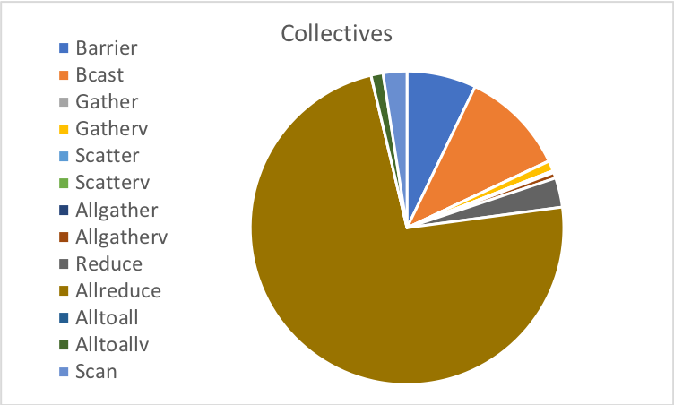
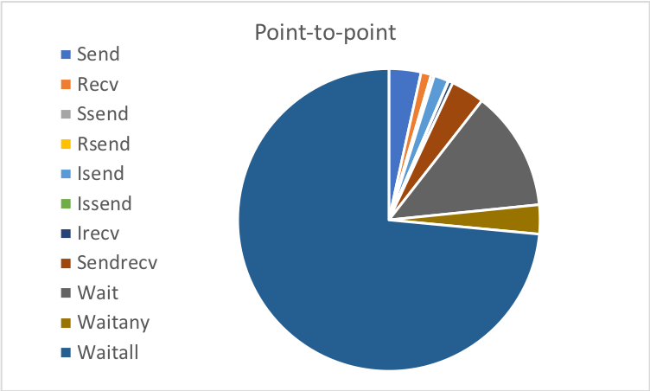
Applications: usage of MPI primitives in Time
34% of the total MPI time is spent in Point-to-point Ops
66% of the total MPI time is spent in collectives
Applications ordered by the compute-to-communication ratio

Slide 42
Why this study?
MPI is a prominent programming model used for production scientific computing
Around 90% of all the applications run on ANL’s production machine (Mira) use MPI
Different applications have different requirements for parallelism and could be using different features of MPI
How scientific computing applications use MPI in production?
It is imperative to glean into the MPI feature set exploration by production applications
To assess how efficiently MPI is being used
Identify areas of concern in terms of performance of MPI features
Why such study was not done already?
Performance overhead with profiling tools
Lack of production quality lightweight profiling tools
Key Insights:
More than half of time is spent in MPI for a reasonably large number of applications
The prominence in terms of time and usage of Collectives is more compared to point-to-point operations
Small message (<= 256 bytes) MPI_Allreduce operations are most heavily used
The usage of Hybrid MPI+OpenMP (or pthreads) programming models is on the rise

Slide 43
Lightweight profiling tool
AutoPerf
AutoPerf collects MPI information and other job information including hardware counters
Enabled by default on Mira, similar to IPM (used in production at NERSC)
Autoperf monitors the MPI usage by intercepting each MPI call using the PMPI interface
Library transparently collects performance data from running jobs
Saves log files at jobs completion
Records MPI usage from all MPI ranks but reports from 4 (exclusive) ranks
Rank 0
Rank that has min. time
Rank that has max. time
Rank that has avg. time
Low overhead – few additional cycles per call
For each of these 4 ranks, it reports {callCount, totalCycles, totalBytes, totalTime} for all and pt2pt & collectives
Data recorded on the average rank is used in this study
Load imbalance across the ranks is not captured
Can incorrectly blame MPI by accounting load imbalance time as MPI time
Notes:
https://www.alcf.anl.gov/user-guides/automatic-performance-collection-autoperf
Cobalt log – get the core hour data
Message size distribution, Time distribution per MPI primitive are not captured
Autoperf logs are available for around ~70% of the jobs run on Mira for the last ~2 years.
Total logs available: 503,067
Total core hours captured through logs: 12,688,109,540,376 (12 trillion seconds)
Job size ranges from 1 to 1,048,576 ranks
Job time ranges from 8 micro-seconds to 24 hours
MPI average bytes are calculated from the buffer size in bytes used for the MPI calls

Slide 44
Autoperf logs - Applications ordered by core-hours (Portion of time in MPI within the application runtime)
Order the 64 applications by their core-hour usage
Average across the runs of the applications; Std. deviation of the MPI fraction across these runs is also captured.
High core-hour usage
low core-hour usage
Notes:
This one (fix std)
Remove benchmarks and jobs taking less than 1 hour.

Slide 45
BACKUP

Slide 46
Limitations of Autoperf 1.0
Limitations:
Message size distribution, Time distribution per MPI primitive are not captured
Only data from 4 ranks is logged and we use only the data from one rank (average) rank – while this is good enough, may not be the best way to do
Incorrectly blames MPI by accounting load imbalance time as MPI time (load imbalance across the ranks is not captured)
Communication create operations are not logged (COMM_WORLD is assumed)
Incorrect MPI message sizes in certain circumstances
MPI_Wait and MPI_Test (issues as mentioned in the IPM github page)
The request handle is from a non-blocking send
The request handle is from a non-blocking collective call
The request handle is from an RMA operation
Reports incorrect message sizes for MPI_Irecv because the message size is calculated from the receive count and datatype arguments. This may be larger than the eventual message because it is legitimate for the sender to send a shorter message
Message sizes for collectives like Alltoallv are not accurate

